Slide 1

Pod 6 Intensive Capstone
Computing Vision: Movie Production Strategy
Samuel Martin, De’Angelo Pillai, Patricio Solorio Cabrera, and Max Schliesman

Slide 2





Meet the team…….. (will update)
Samuel Martin
Max Schliesman
De’Angelo Pillai
Patricio Solorio Cabrera
PMD Sponsor aka Fearless leader
“Super BA”
Passionate about developing BA/Cs and making sure they don’t waste time creating slides from scratch
Initiative Lead aka Creative Director
Wannabe BA
Loves mooching slides from her talented and more artistic peers
Outreach Lead aka the reason you got so many scrapbook emails
Known for constantly saving PowerPoint after every other click
Has shamelessly pulled inspiration from this deck since its inception
Content development aka I just sorted a lot of slides
No
(Anything else we want to say about ourselves)

Slide 3
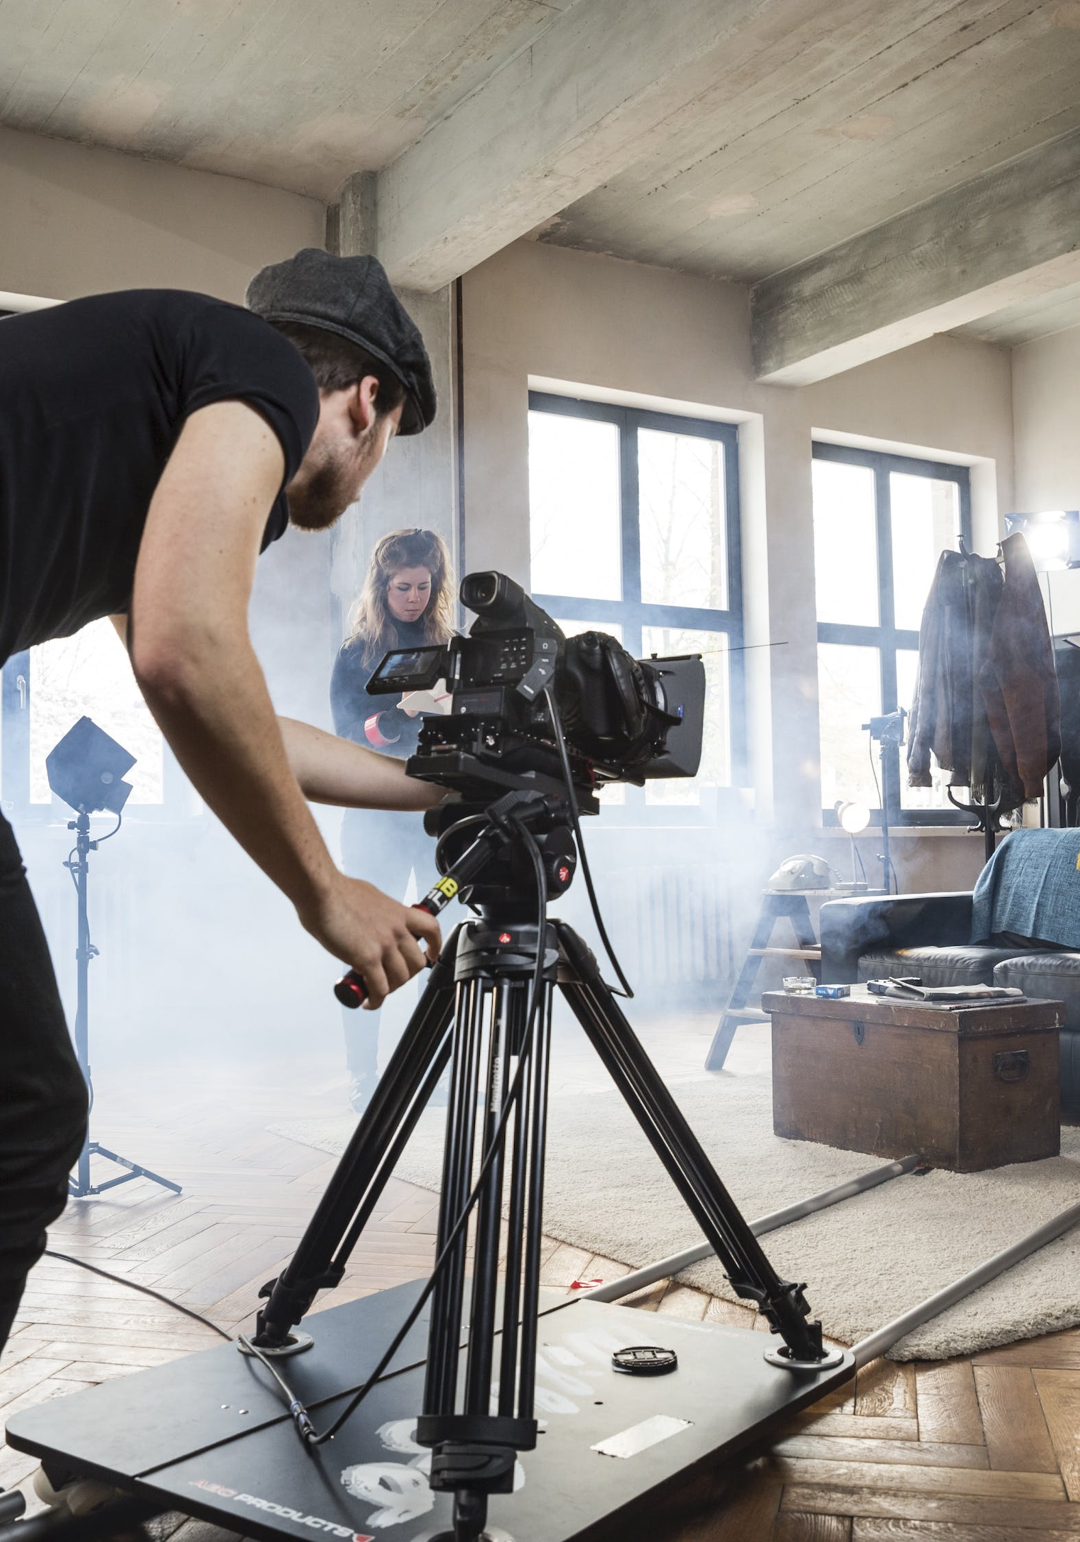
Computing Vision Case
Spend optimization
SITUATION
Computing Vision seeks a competitive advantage against other studios in the movie production industry. They are entering a highly congested market and need to optimize their product through data analysis. Adapting to customer conscious and subconscious preferences which enable C.V. to cater to a larger audience and drive greater profits.
SOLUTION
Developed spend baseline to uncover spend visibility categories to identify opportunities of ineffective spend
Developed and Refined Opportunity Areas to identify benefits of global coordination and quick wins
Validated Opportunity Areas and Developed Pilots to prepare for handover and implementation
IMPACT
Deloitte partnered with in-region marketers to categorize non-working spend across brands to create spend transparency utilizing our Excel Transparency Tool.
Deloitte identified opportunities to focus on priority categories and brands and align investments with global strategy, while shifting investment allocations to support the increased role of franchises.
ESTIMATED NET SAVINGS OF …
27.5%
IN A&P IMPROVEMENT POTENTIAL ACROSS FOUR KEY OPPORTUNITY AREAS
5.5%
IN ESTIMATED REALIZABLE POTENTIAL IN FIRST 6 MONTHS
Notes:
Tags: qual, image, text

Slide 4
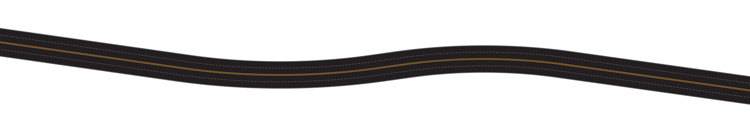
Insights Discovered Through Data Analysis
Subheader Placeholder
Genre
Computing Vision should specialize in …. It has the ___ reviews and grosses ____
Investment to Rating Assessment
How much money should each movie cost to produce. What is the marginal cost of ratings percentages
Run Time
Computing Vision produced movies should be between __ and __ to captivate the audience without boring them
Anything Else
We will see
Notes:
Tags: text, rules of the road

Slide 5

Genre Analysis
Digital use is evident throughout the entire purchase decision; but many CPGs do not use a multi-touch model to drive brand connectivity
THE DATA
This is Where the Graph Goes
53%consumers use digital to become aware of brands and products
62% said digital made it easy to learn about the products
FIND INSPIRATION
84% consumers use digital to browse / research products
41% said digital made it easy to compare product information
BROWSE AND RESEARCH
64% consumers use digital to seek product advice or input
45% said digital helped them gain knowledge about the product
SELECT AND VALIDATE
Notes:
Tags: data visualization, survey, results, icons, circle

Slide 6
Ideal Run Time
Only 26% of companies are currently implementing digital transformation initiatives across their supply chain
IT and Technology
The use of digital initiatives in other industries has resulted in a dramatic increase in business benefits, ranging from greater customer engagement to optimized supply networks.
Digital maturity (1 to 10 scale)
Electronics
Construction and Real Estate
Automotive
5.30
Telecommunications/Communications
5.00
Retail
Aerospace and Defense
Chemicals
4.70
Pharmaceuticals and Biotechnology
Transportation, Travel, Tourism
Consumer Goods
Energy and Utilities
4.40
Logistics & Distribution
Agriculture and Agribusiness
4.10
Healthcare Services
Oil and Gas
Manufacturing
3.80
2.20
2.50
2.80 3.10 3.40
Enterprise digital strategy horizon (in years)
3.70
4.00
Notes:
Tags: data visualization, bubble chart

Slide 7
Investment to Ratings Assessment
Data Visualization & Infographics
The U.S. Integrated OR market is expected to grow at 3-4% CAGR, to $2.5Bn by 2022
U.S. Total Equipment Market
TAKEAWAYS
The rate of innovation introducing new technologically advanced OR capabilities such as system integration, higher definition imaging, and telemedicine is a key driver of the overall U.S. OR integration and equipment market
As the number of OR surgeries is growing due to proliferation of chronic diseases and minimally invasive procedures targeting aging demographics, so too will hospitals’ demand for cost-effective integrated ORs
Market trends show increased opportunities for vendors to bid for integrated solution packages that include service and maintenance as the install base of integrated ORs grows
Hospitals and Ambulatory Surgical Centers (ASCs) view the OR as a revenue generator, prompting additional investments to increase utilization and efficiency primarily through OR renovations and system integration upgrades
Notes:
Tags: data visualization, bar chart, growth

Slide 8
Key Takeaways
Outcomes
Growth
Provides a single forum for leaders to actively decide and commit to disproportionately investing in the key opportunities that will grow our businesses at the portfolio level
ROI
Allows leaders to actively track and manage our investments and provides a channel to create value-based conversations around future allocation
Performance
Creates the vehicle to manage opportunity traction, and risk along the entire investment lifecycle to ensure our C&M investments are performing at or above their opportunity cost
Efficiency
Delivers scale-efficiencies by creating a single, transparent investment management process, effectively minimizing the ad hoc analysis and reporting required for opportunities and assets
Consistency
Establishes a consistent message across the top on how high-value initiatives are evaluated regardless of their lifecycle (from ideation through full maturity) and source
Notes:
Tags: text, list, icons

